Slide 1
Hierarchical clustering
Joseph Nelson, Data Science Immersive

Slide 2
Agenda
What is hierarchical clustering?
How does hierarchical clustering work?
Code Implementation

Slide 3
What is hierarchical clustering?
Review: what is clustering?

Slide 4
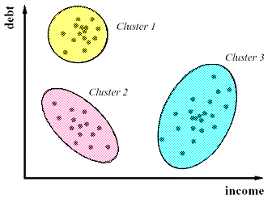
What is clustering?
Review: what is clustering?
Clustering is an unsupervised learning technique we employ to group “similar” data points together
With unsupervised learning, remember: there is no clear objective, there is no “right answer” (hard to tell how we’re doing), there is no response variable, just observations with features, and labeled data is not required

Slide 5
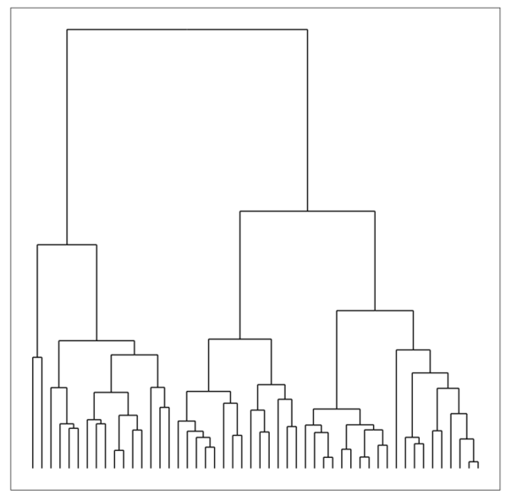
What is hierarchical clustering?
Hierarchical clustering, like k-means clustering, is another common form of clustering analysis. With this type of clustering - we seek to do exactly what the name suggests: build hierarchies of links that ultimately form clusters.
Once these links are determined, they are displayed in what is called a dendrogram - a graph that displays all of these links in a hierarchical manner.

Slide 6
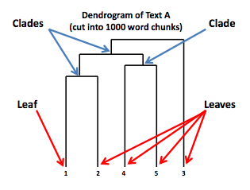
What is hierarchical clustering?
A dendrogram is a branching diagram that represents the relationships of similarity among a group of entities
The arrangement of the clades tells us which leaves are most similar to each other. The height of the branch points indicates how similar or different they are from each other: the greater the height, the greater the difference
Because of this, hierarchical clustering is best served on SMALLER datasets

Slide 7
How does hierarchical clustering work?
In hierarchical clustering, instead of clustering in one step, the clusters are determined in the a varying number of partitions. At each step, it makes the best choice based on the surrounding datapoints, with the ultimate goal that these best choices will lead to the best choice of clusters overall. Given the algorithm's method of calculating linkages based on immediate datapoints, it's known as a greedy algorithm.

Slide 8
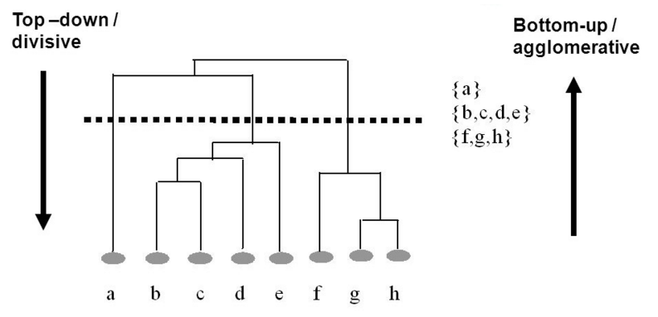
How does hierarchical clustering work?
There are two forms of hierarchical clustering; agglomerative hierarchical clustering and divisive hierarchical clustering.

Slide 9
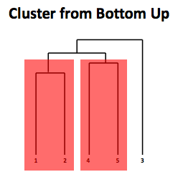
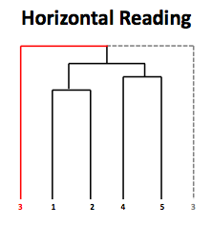
How does hierarchical clustering work?
There are two forms of hierarchical clustering; agglomerative hierarchical clustering and divisive hierarchical clustering.

Slide 10
How does hierarchical clustering work?
We're going to look at one of the most fundamental methods for agglomerative hierarchical cluster, known as linkage clustering. Linkage clustering iterates through datapoints and computes the distance between groups by computing the distance between two neighboring datapoints, using the nearest neighbor technique that was also used by KNN.
To think about the difference between agglomerative vs divisive, with the former we start with the leaves of the tree and build the trunk, and with the latter we start with the trunk of the tree and build the leaves. Both methods are applicable when using hierarchical clustering, it's just a matter of computational preference

Slide 11
implementation
Implementing hierarchical clustering in python is as simple as calling a function from the SciPy toolbox:
Z = linkage(X, 'ward')
Here, "X" represents the matrix of data that we are clustering, and "ward" tells our algorithm which method to use to calculate distance between our newly formed clusters - in this case Ward's Method which seeks to minimize the variance when forming clusters. When calculating distance, the default is Euclidean distance which we learned about in our dimensionality reduction lesson.

Slide 12
implementation
After we cluster, we can calculate the dendrogram using a simple dendrogram() function from SciPy, which we can then draw using our handy plt from matplotlib.
To check how well our algorithm has measured distance, we can calculate the cophenetic correlation coefficient. This metric, which measures the height of the dendrogram at the point where two branches merge, can tell us how well the dendrogram has measured the distance between data points in the original dataset and is a helpful measure to see how well our clustering test has run.
c, coph_dists = cophenet(Z, pdist(X))

Slide 13
Coding implementation
To the repo…

